Slide 1

SQL Injection
Volume 3, Module 5, v12, with v13 additions at the end

Slide 2

SQL Injection Concepts
SQL: Structured Query Language
  Used to interact with DB
SQL Injection: malicious SQL statements to manipulate the DB
SQL Injection Consequences:
  Authentication Bypass
  Authorization Bypass
  Information Disclosure
  Compromised Data Integrity
  Compromised Data Availability
  Remote Code Execution

Slide 3
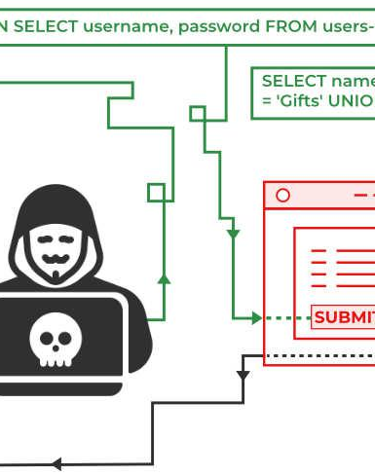
SQL Injection Types
In-band SQL Injection
Blind/Inferential SQL Injection
Attacker manipulates an applications SQL query through user input fields.
Occurs when an attacker exploits a vulnerability in an application without seeing the results.

Slide 4

SQLi Tools
SQLMap (Open sources SQLi detection tool)
Burp Suite (Automated and manual combined)
Havij (GUI ease of use 95% success rate of attack)
Imperva (Advanced Reporting and automation)
SQLi Injection (Java based tool)
SQLi Tools Mobile Devices
SQLi

Slide 5

SQLi Detection Tools
OWASP ZAP (https://www.owasp.org)
Damn Small SQLi Scanner(DSSS) (https://github.com)
Snort (https://snort.org)
Burp Suite (https://www.portswigger.net)
SolarWinds® Log & Event Manager (https://www.solarwinds.com)
AlienVault USM (https://www.alienvault.com)

Slide 6
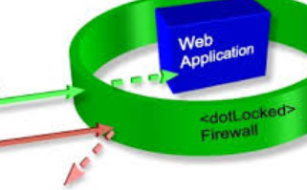
Evading SQLi Detection
Signature Evasion Techniques
  In-line Comment
  Char Encoding
  String Concatenation
  Obfuscated Code
  Manipulating White Spaces
  Hex Encoding
  Sophisticated Matches
  URL Encoding
  Null Byte
  Case Variation
  Declare Variables
  IP Fragmentation
  Variation

Slide 7

Countermeasures
Common Web Applications Vulnerabilities
The database server runs OS commands
Using a privileged account to connect to the database
Error message revealing important information
Defense mechanisms
Minimizing Privileges
Firewalling the SQL Server
Use Type-Safe SQL Parameters
In the Application: Input Validation, Output Encoding, Enforce Least Privilege

Slide 8

Review
SQLi attack methods a few reviewed
In band SQLi attack
Out of band SQLi attack
SQL attack tool types Havij 95% success rate
SQLi detection tools, such as Solarwinds
SQL prevention, sanitize input

Slide 9
CEHv13 Update – Modern SQL Injection Threats
CEHv13 introduces new contexts for SQL injection:
  API-based SQLi in REST/GraphQL interfaces where input is less validated
  NoSQL injection and hybrid database attacks (e.g., MongoDB injection)
  Injection in mobile backends and cloud-hosted DB services
Increased focus on:
  Automated payload generation using AI-driven fuzzers
  Attack chains combining SQLi with privilege escalation or lateral movement
Tool enhancements:
  Updated features in sqlmap, Havij, and Burp Suite extensions with logic-based inference

Slide 10
CEHv13 Update – SQL Injection Defense Strategy
Enhanced security practices now include:
  Parameterized queries and stored procedures by default
  Context-aware input validation across APIs and serverless functions
  Detection via behavioral anomalies in DB queries (e.g., frequency, volume, response timing)
CEHv13 emphasizes:
  Scanning with updated DAST tools integrated in CI/CD pipelines
  Aligning to OWASP API Security Top 10 and SSDF controls
  Use of real-time database activity monitoring (DAM) for threat response

Slide 11

Wireless Hacking
Hacking intercept WPA2 Personal Password Intercept and Crack
Volume 4, Module 1, v12, with v13 additions at the end

Slide 12
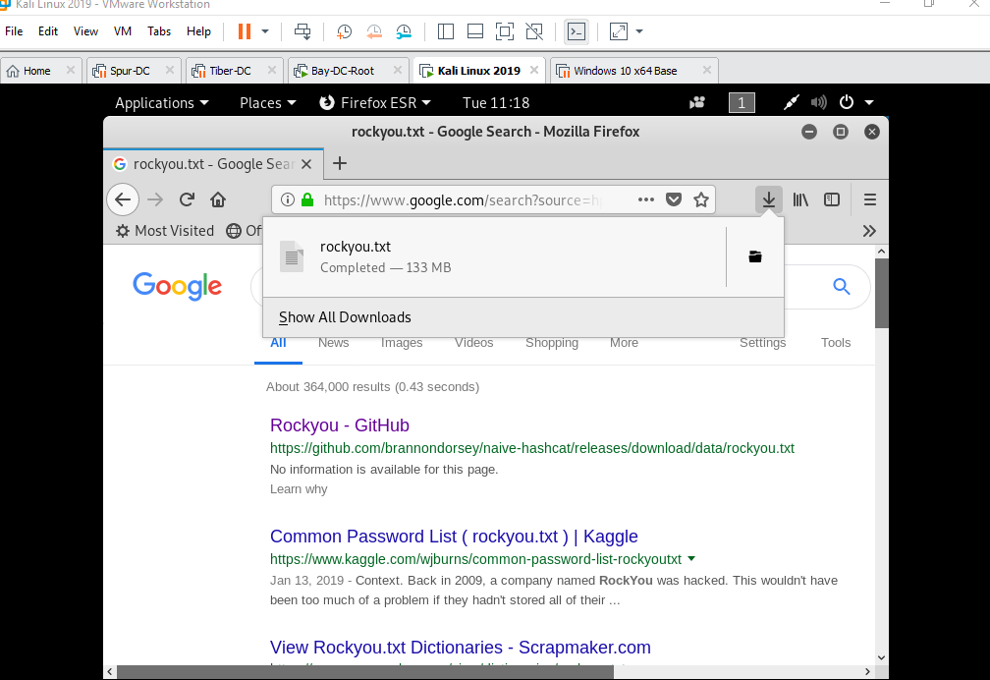
First: Obtain Password Dictionary File
Go to any browser and type in Rockyou.txt this is a text file with a tremendous amount of plain text passwords that will be used by aircrack-ng
Once we have downloaded the file, we need to make sure that it is copied and placed in the Home directory of Kali Linux.

Slide 13
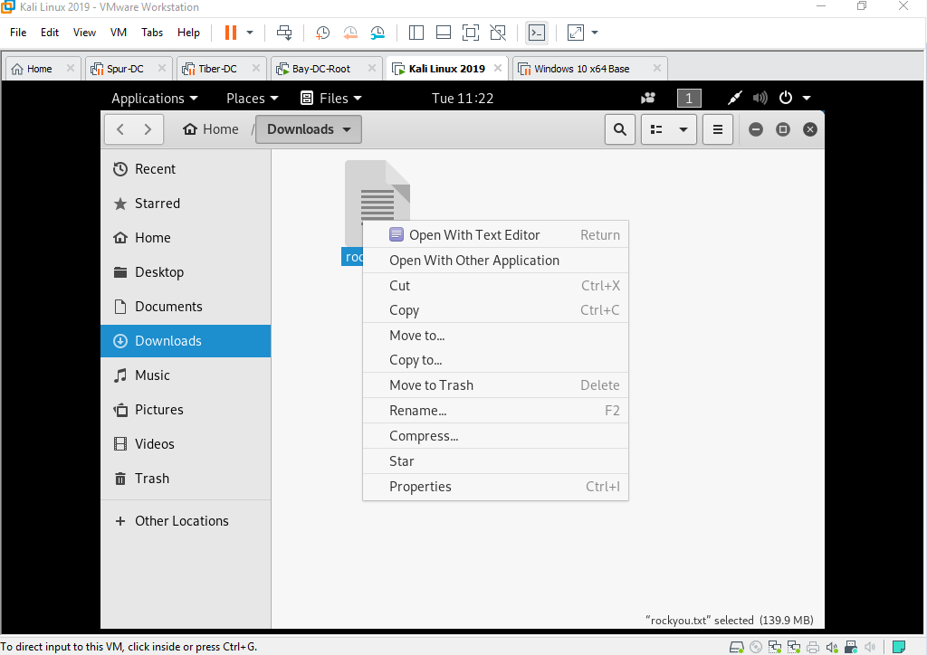
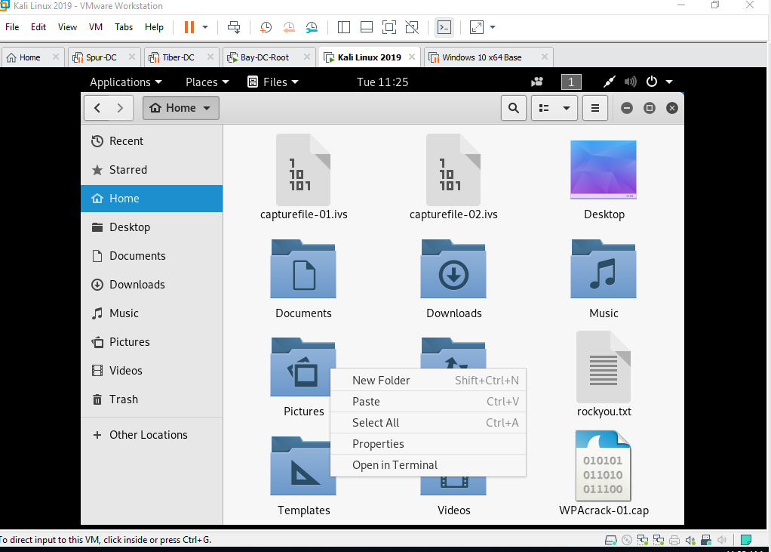
Copy to Home of Kali Linux

Slide 14
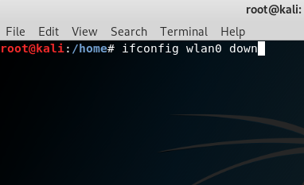
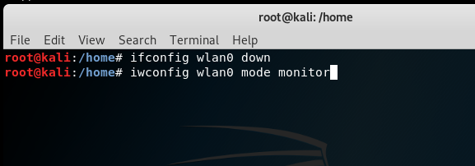
Configure for Monitor Mode
Start a new terminal session and type ifconfig verify that the WLAN0 is connected this would assume you know how to connect an external device in VMWARE
1
Type ifconfig wlan0 down
Hint: This command disables the Wireless Radio so we can change the configuration to monitor mode.
2
Iwconfig wlan0 mode monitor
Hint: This changes the Wireless radio to monitor traffic
3
Type ifconfig wlan0 up
4

Slide 15
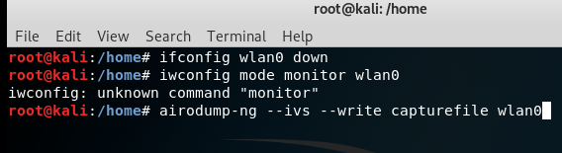
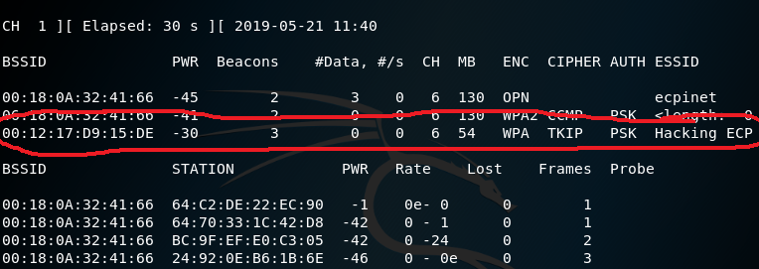
Let’s Monitor all Traffic Client and Access Point
Type: airodump-ng –ivs –write capturefile wlan0
Hint: Case sensitive; be careful here.
Then: Hit Enter and watch the wireless traffic accumulate on the screen.
Now, target a specific AP and Client.

Slide 16
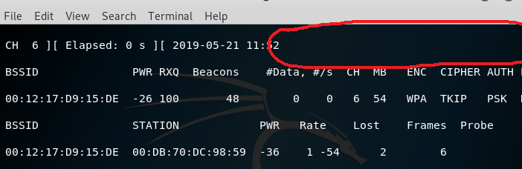
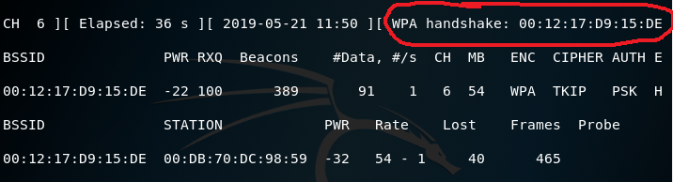
Targeting Wireless Station and Client
Try it yourself
First thing to do is identify the target from the previous slide do you see Hacker ECPI? Lets target the Channel and the SSID
1
Type: sudo airodump-ng –c 6 –bssid 00:12:17:D9:15:DE –w WPAcrack wlan0 –ignore-negative-one
Side Note > The Hex code is the SSID 00:12:17 etc. and the –c 6 is the target channel
2
One you hit enter then go to another wireless device and select the Access Point you want to access. Watch the Capture of the Password as the handshake occurs.
3
Hint: You have to target my channel and SSID due to the timing limitations as this handshake occurs very fast.

Slide 17
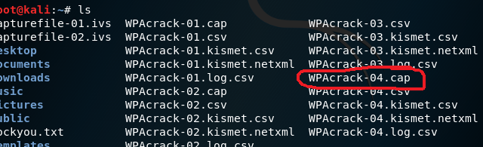
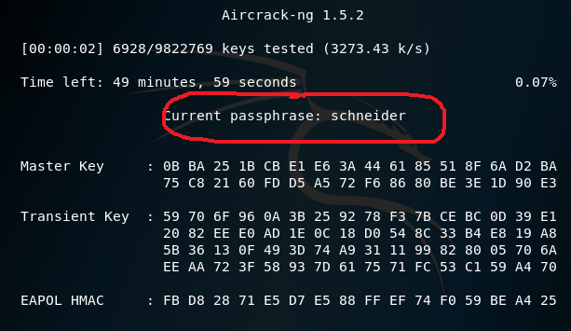
Time to Crack the Password that was Captured
First Verify your WPAcrack-04.cap this can be done with a ls in the home directory. You will select the most current capture file in this image it is WPAcrack-04.cap
1
This is the file where we are going to run aircrack. Are you ready? Let’s go!
Hint: Remember that we must run the most recent capture we do this to ensure we captured the correct Access Attempt.
2
Aircrack-ng –w rockyou.txt –b 00:12:17:D9:15:DE WPAcrack-04.cap
Hint: This command will run aircrack-ng and crack the password if it is in the Rockyou.txt list.
3
This is the Password cracker while it is running attempting each word in the Rockyour.txt file.
4

Slide 18
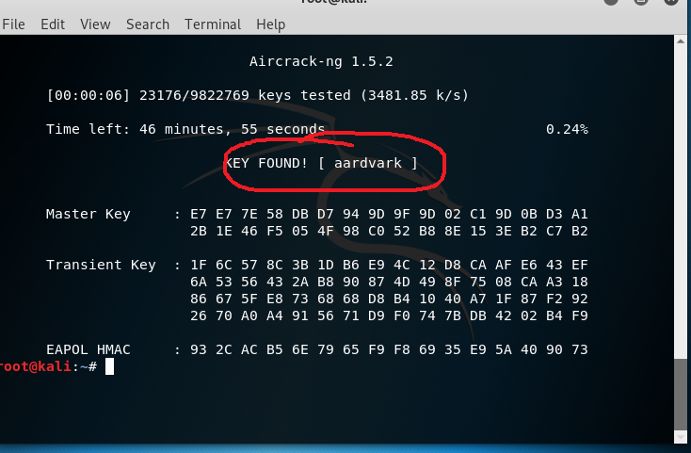
Password is now Cracked; Here it is!!!
It might take a while depending upon how deep the password is in the list.
How it works: The Password is aardvark

Slide 19
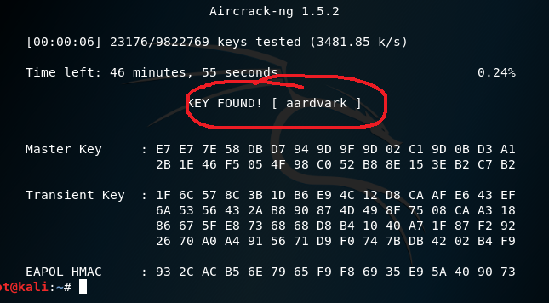
Background on the Cracking Process
Aircrack-ng requires the SSID and the WPAcrack-01.cap file. WHY?
1
When the password cracker runs it actually creates a hash of each word
Hint: Once a hash is created of each word then it checks it against the hashed capture.
2
Password hash = Password Capture
Hint: Once this statement is true then it stops the process
3
Once process is stopped it displays the last word that was being compared.
4

Slide 20
CEHv13 Update – Advanced Wireless Attack Trends
CEHv13 highlights emerging wireless threats:
  WPA3 downgrade attacks and forced fallback to WPA2
  Evil Twin + Captive Portal attacks using rogue APs and social engineering
  Integration of AI with aircrack-ng and hashcat for optimized dictionary attacks
Attack vectors now include:
  Bluetooth Low Energy (BLE) fuzzing
  Wi-Fi 6 protocol misconfigurations
  IoT device wireless onboarding vulnerabilities

Slide 21
CEHv13 Update – Wireless Defense Enhancements
New recommendations in CEHv13 for wireless security:
  Upgrade to WPA3-Enterprise with Protected Management Frames (PMF)
  Implement 802.1X with certificate-based authentication
  Use wireless intrusion prevention systems (WIPS) with machine learning
Emphasis on real-world practices:
  Disable broadcast SSIDs, enforce MAC filtering, and monitor channel behavior
  Detect anomalies using tools like Kismet, Wireshark, and cloud-integrated WIPS
Framework references:
  Aligns with MITRE ATT&CK T1557: Adversary-in-the-Middle
  Includes OWASP Mobile and IoT cross-references

Slide 22

Hacking Wireless Networks
Volume 4, Chapter 1

Slide 23

Wireless Concepts
Wireless Network Advantages:
  Easy to install
  Connectivity where cabling is difficult
  Mobility
Wireless Network Disadvantages:
  Security
  Bandwidth limitations
  Interference
Types:
  Extensions to a wired network
  Multiple APs
  LAN-to-LAN Wireless Network
  3G/4G Hotspot
Notes:
A wireless network is an unbounded data communication system that uses radio-frequency technology to communicate with devices and obtain data. This network frees the user from complicated and multiple wired connections using electromagnetic (EM) waves to interconnect two individual points without establishing any physical connection.

Slide 24
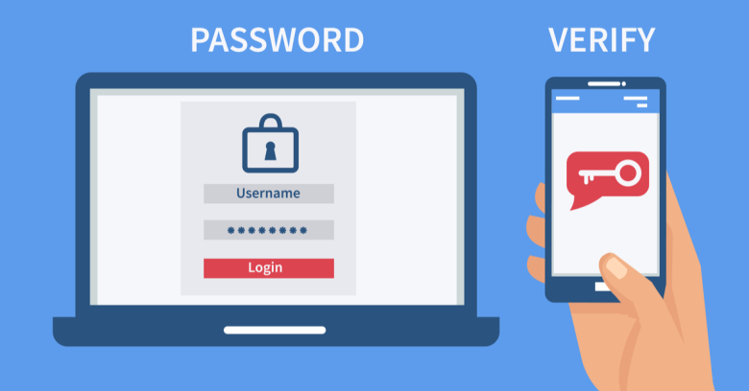
Authentication and Encryption
Radius Server Authentication
  Centralized Management
  Individual Credentials
  Scalability
  Enhanced Security Features (EAP)
Wireless Encryption
  802.11i
  WEP – (Not secure)
  WPA – (Not Secure)
  WPA2 – (Vulnerabilities)
  WPA3 – (Currently the most secure)

Slide 25
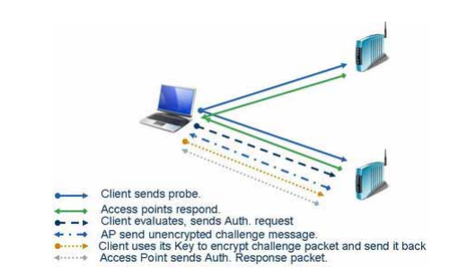
Wireless Four Way Handshake
WPA:
Access Point sends a Nonce value (arbitrary number single use)
Client responds with a different SNounce (its own arbitrary value)
Access Point verifys message from client then sends an Anounce (random number generated by AP)
Client sends a confirmation to the AP that the temporal keys have been installed for this session.

Slide 26

Issues with WPA Security
WPA:
Weak passwords
Dictionary Attacks
KRACK vulnerability (Key Reinstallation attack)
Vulnerable to wireless DoS

Slide 27

Wireless Threats
Access Control Attacks (WarDriving, Rogue AP, MAC Spoofing, AP misconfiguration, Ad hoc associations)
Integrity Attacks (Data-Frame Injection, WEP Injection, Bit-Flipping, Extensible AP Replay, Data Replay, Initialization Vector, Replay Attack, RADIUS Replay, Wireless Network Viruses)
Availability Attacks (Disassociation, EAP-Failure, Beacon Flood, DoS, De-authenticate attack)
Rogue AP Attack

Slide 28

Wireless Antenna Types
Unidirectional Antenna
Parabolic Grid Antenna (Semi dish design long distance)
Dipole Antenna (radiates signal in all direction)
Yagi Antenna ( High gain and directional)
Omni directional Antenna (radiates in 360 degress)
Cantenna (Directional antenna usually homemade with a pringles can because it must be some type of metal)

Slide 29

Wireless Hacking Methodology
Wi-Fi discovery
GPS mapping
Wireless traffic analysis
Launch wireless attack
Wi-Fi encryption cracking
Wi-Fi network compromise

Slide 30
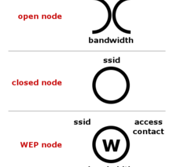
Wi-Fi Discovery
Wireless Network Footprinting – passive/active
Find Wi-Fi Networks in Range to Attack
Find WPS-Enabled Aps
Wi-Fi Discovery Tools:
  inSSIDer Plus (https://www.metageek.com)
  NetSurveyor (http://nutsaboutnets.com_
  OpenSignalMaps (https://opensignal.com)
  Network Signal Info Pro (http://www.kaibits-software.com)

Slide 31
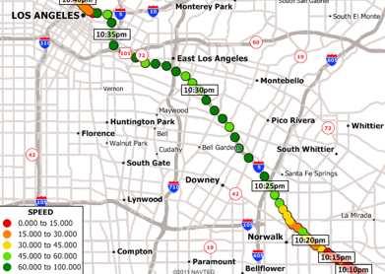
GPS Mapping
Map a target wireless network
Tools:
  WiGLE (https://wigle.net)
  Maptitude Mapping Software (https://www.caliper.com )
  ExpertGPS (https://www.expertgps.com)
  GPS Visualizer (https://www.gpsvisualizer.com)
  TrackMaker (https://www.trackmaker.com)

Slide 32
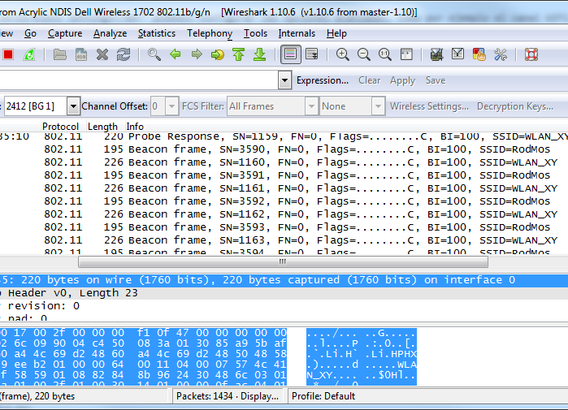
Wireless Traffic Analysis
Helps the attacker find vulnerabilities, susceptible victims and appropriate attack strategy
Tools:
  Wireshark with Npcap (https://www.wireshark.org)
  RF Explorer (http://rfexplorer.com) (spectrum analysis)

Slide 33

Launch Wireless Attacks
Tools:
Aircrack-ng Suite (http://www.aircrack-ng.org)
Technitium MAC Address Changer (https://technitium.com)
Kismet (https://www.kismetwireless.net)
AirMagnet WiFi Analyzer PRO (https://www.netally.com)

Slide 34
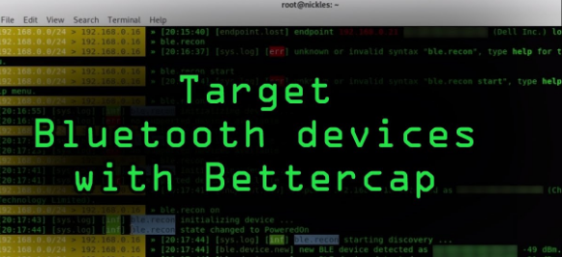
Bluetooth Hacking
Bluesmacking
Bluejacking
Bluesnarfing
Other:
  BlueSniff
  BluePrinting
  Btlejacking

Slide 35
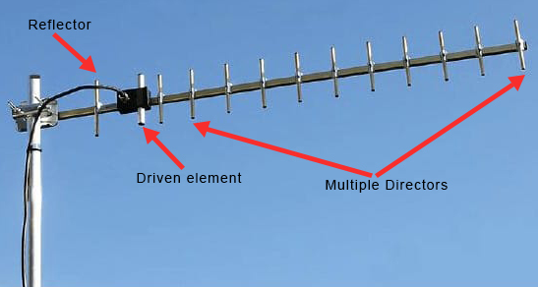
Summary
WPA 3 is more secure than previous versions
The four-way handshake for WPA2 can be compromised with Krack-Attack
Wireless connection presents multiple points of entry into the network
Understanding antenna types can help to mitigate available access

Slide 36
CEHv13 Update – Expanded Wireless Attack Vectors
CEHv13 introduces extended coverage of:
  Bluetooth-based attacks: Bluesnarfing, Btlejacking, and device spoofing
  BLE fuzzing to trigger unauthorized actions or crash IoT systems
  Rogue AP and Evil Twin attacks using social engineering overlays
Updated emphasis on:
  Wi-Fi 6 and WPA3-specific misconfigurations
  Attacks on wireless mesh networks and IoT device provisioning protocols
  Integration of GPS mapping and real-time geolocation recon using tools like WiGLE and Kismet

Slide 37
CEHv13 Update – Advanced Wireless Defense & Tooling
CEHv13 wireless defense updates include:
  Monitoring with AI-enabled WIDS/WIPS (e.g., Aruba, Cisco Meraki)
  Enhanced Wi-Fi network hardening with:
    MAC filtering, PMF (Protected Management Frames)
    802.1X authentication with EAP-TLS
  Detection of signal anomalies and RF spectrum abuse
Updated toolset includes:
  Aircrack-ng with hashcat GPU cracking for password testing
  RF Explorer & Wireshark/Npcap for wireless traffic analysis
  MobSF (for mobile/Wi-Fi integrated pentests)

